Slide 1
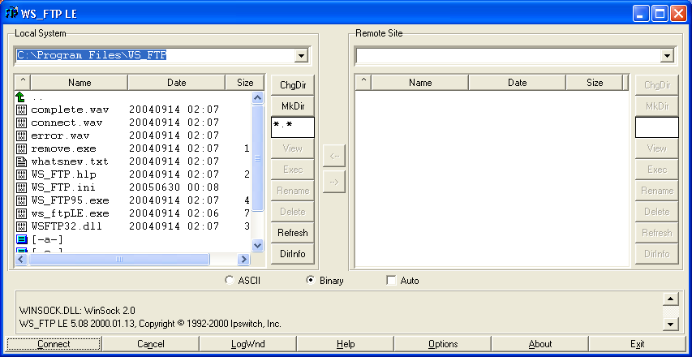
CISW 400 (Online) – Client-side Scripting for the Internet
PRESENTATION 1d:
Uploading to the
CRC Server
Cosumnes River College
Fishman – 2020
CISW 400 - CRC Fishman 2019 / 2020

Slide 2
Uploading Procedures
Student Accounts
Using WinSCP
Troubleshooting
CISW 400 - CRC - Fishman 2019 / 2020

Slide 3

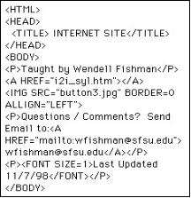
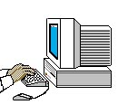
Uploading Procedures:
Student Accounts:
Each student in this class has been given an account on the CRC CIS Web server.
CIS Web Server
CISW400 Student
USERNAME = letter “w” followed by your student ID
PASSWORD = new2mini
To check out your web address, visit:
https://cisw2.crc.losrios.edu/~username
Where username = letter “w” followed by 7-digit student ID#
CISW 400 - CRC - Fishman 2019 / 2020

Slide 4

Uploading Procedures:
Notes:
Unix /Linux Server protocol
Each student has a public_html directory on the server. Your default homepage filename is index.htm.
Do not change your password.
Everyone has the same password for logging onto the server (password=new2mini). Do not attempt to change it.
Filenames
Pay attention to Unix filename conventions in order to reduce possible problems on the server. Avoid spaces and special characters in your filenames and remember Unix is case-sensitive.
OK
NOT OK
page1.htm
Page_one.html
page 1.html
page#1!.htm
CISW 400 - CRC - Fishman 2019 / 2020

Slide 5
Uploading Procedures
Overview
Using WinSCP
Assignments Menu
CISW 400 - CRC - Fishman 2019 / 2020

Slide 6

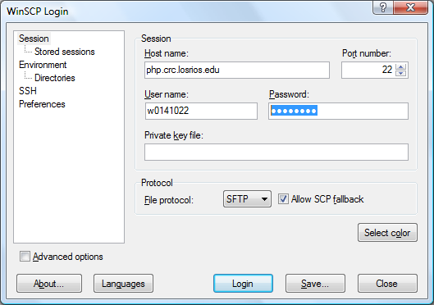
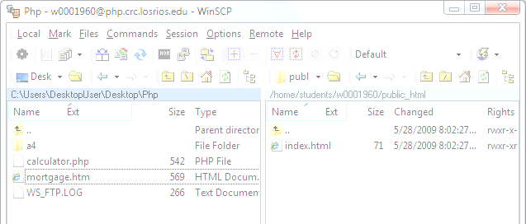
Using WinSCP
To connect to the server with WinSCP, use the following:
A free download of WinSCP is available at http://winscp.net/eng/download.php
Host name = cisw2.crc.losrios.edu
cisw2.crc.losrios.edu
Username =
“w” + student ID#
Password = new2mini
Once you have entered Hostname, Username, and Password, you may
Save your settings, then click Login.

Slide 7
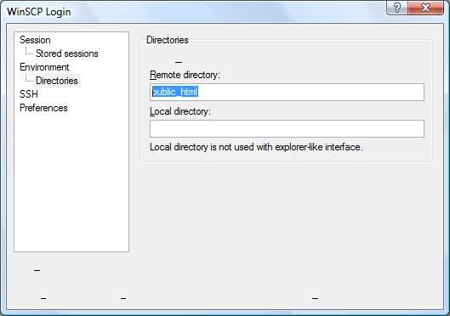
Using WinSCP
Optional:
If you wish to save a few steps, you can preset which directories will be automatically opened, both on the server and on your computer
You can set it to automatically open the public_html folder every time you connect.
Click Directories in the left Nav bar.

Slide 8
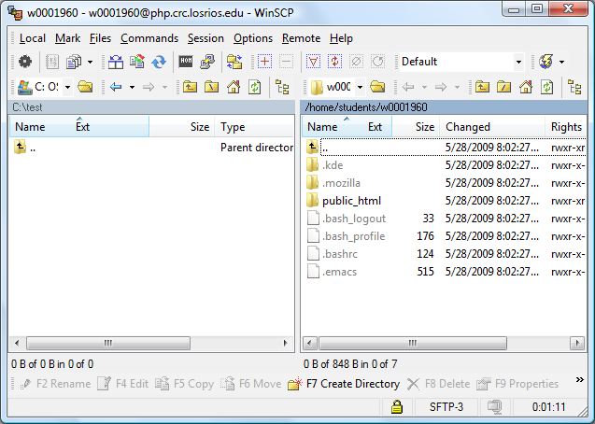
Using WinSCP
Once you login to the server, you’ll see a split screen interface. The left-side corresponds to your local computer, and the right-side is your folder on the server.
Left = local
Right = remote

Slide 9
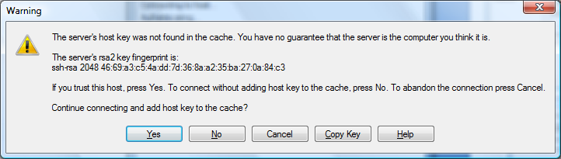
Using WinSCP
Problems?
If you receive the following Warning (see below), click Yes and continue.
If you are unable to connect to the server, re-type your
information very carefully. And if you are still unable to
connect, notify your instructor.
CISW 400 - CRC - FISHMAN 2019 / 2020

Slide 10
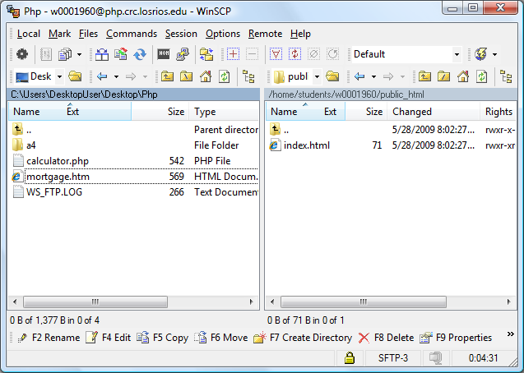
Using WinSCP
Before you transfer files, make sure that you are inside the public_html directory (on the right-side).
Double-click on the public_html folder, if necessary.

Slide 11

Using WinSCP
To transfer files, you can drag & drop from one side to the other
Click and drag the category lines, if you need to read a long filename.
You can also drag and drop files from your desktop over to the server-side.

Slide 12
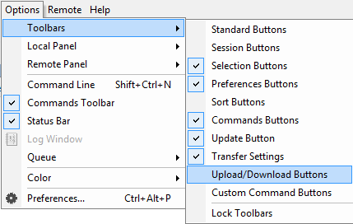
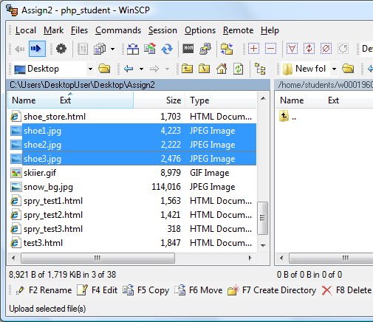
Using WinSCP
If you prefer using Upload/Download arrow buttons, make sure they are turned on.
Under Options, Toolbars, click to check Upload/Download Buttons
To transfer, select file(s) then click the right arrow to upload.

Slide 13
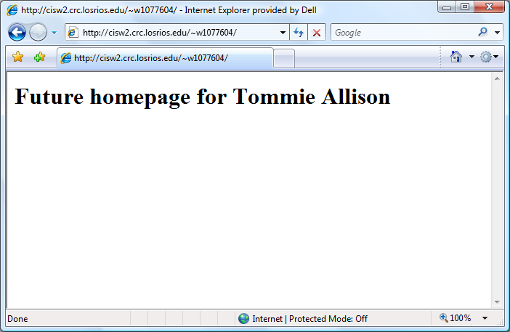
Using WinSCP
To view your web documents online, open a browser and enter your URL:
https://cisw2.crc.losrios.edu/~userID
(where userID = letter “w” followed by student ID# )
https://cisw2.crc.losrios.edu/~w0419280

Slide 14
Uploading Procedures
Overview
Using WinSCP
Assignments Menu
CISW 400 - CRC - Fishman 2019 / 2020

Slide 15
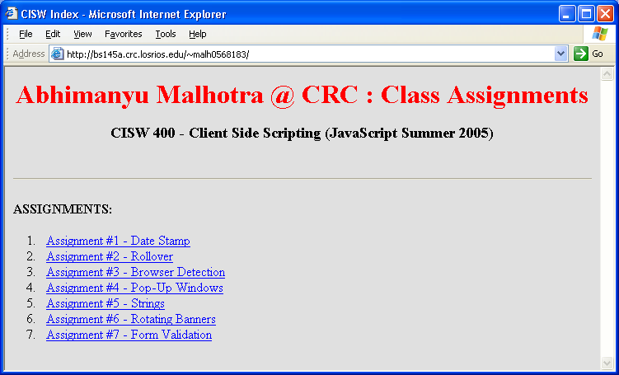
Assignments Menu
Your first Assignment in this class is to create a menu web page which will contain links to all of the other assignment web pages that you complete in this class.
https://cisw2.crc.losrios.edu/~w0419280
CISW 400 - CRC - Fishman 2019 / 2020

Slide 16
Assignments Menu
As mentioned previously, type the following URL to visit your class homepage on the server:
https://cisw2.crc.losrios.edu/~username
Where username = letter “w” followed by 7-digit student ID#
The page that comes up is your index.htm file. For Assignment #1, you will need to modify the existing index.htm file in order to customize your own class page menu.
http://cisw2.crc.losrios.edu/~w0419280

